Slide 1


Grocery Management System
Assessment: SOFTWARE DEVELOPMENT PRESENTATION 1
Hassaan Ali : 0383633

Slide 2
Grocery Management System
?
Introduction
In the retail industry, the grocery management system is a key tool for improving and streamlining grocery shop operations. Successful inventory management, order processing, and customer interactions are critical components of the grocery industry's dynamic and competitive landscape. These issues are addressed by the grocery management system, which provides a centralized platform for managing inventory, orders, clients, and other crucial elements of grocery shop operations.

Slide 3


Purpose
The main purpose of the grocery management system is to give managers and owners of grocery stores an advanced tool for efficiently running their businesses. This covers order fulfilment, inventory management, and customer service all essential elements of the food retail ecosystem. Through the integration of critical features and the automation of repetitive processes, the system minimizes human error and effort while increasing total productivity.

Slide 4
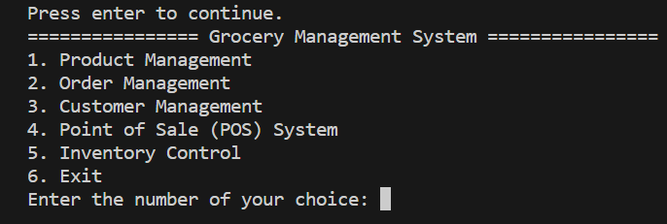
Grocery Management System Main Menu
Product management main menu
Order management main menu
Customer management main menu
Point of sale (POS) main menu
Inventory control main menu

Slide 5
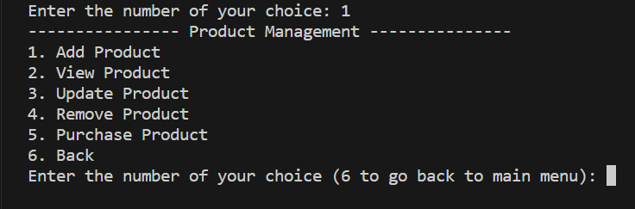
Product Management Main Menu
Add Product
View Product
Update Product
Remove Product
Purchase Product

Slide 6
Order Management Main Menu
Place order
View order
Update order
Customer Management Main Menu
Add Customer
View Customer
Update Customer
View Purchase History

Slide 7
Point of Sale (POS) Main Menu
Add to Cart
View Cart
Checkout
Inventory Control Main Menu
View Stock
Receive Stock
Set Low-Stock Alert

Slide 8

Future Work
GUI interface using Tkinter: from command line to GUI-based grocery management system with UX/UI experience design.
User authentication system: by using user authentication, adding login and logout features with the owner.
Database integration (MySQL): in this command line-based system there is only a list or dictionaries used but to make our application powerful a database is a must locally or cloud-based.

Slide 9

Conclusion
The creation of the grocery management system is evidence of how practical solutions and technology innovation have come together in the grocery retail industry. Python's readability, ease of use, and wide library support made it the perfect programming language for creating a flexible and intuitive application. Functionality, command line interface, and integration issues were carefully handled during the testing process, highlighting the vital significance that thorough testing plays in guaranteeing the system's dependability.

Slide 10
THANK YOU!

